Slide 1
Diffusion Mumbling
Ganchao Wei

Slide 2




1. Weighting (unifying framework)
DDPM:
Score Matching:
Flow Matching:
Look similar (source is $ε\sim N(0,I)$):
Integrate over $t\sim U(0,1)$
Conditional on endpoints $x$, build interpolation between $ε$ and $x$
Differences:
Network output
Loss weight
Interpolation design/ forward process
Let’s unify them!

Slide 3
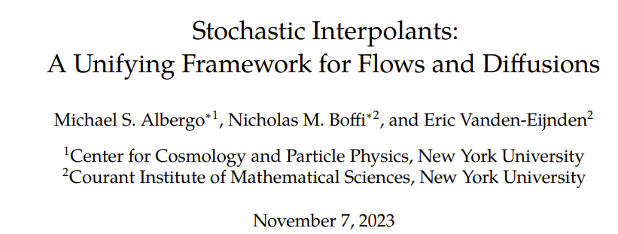
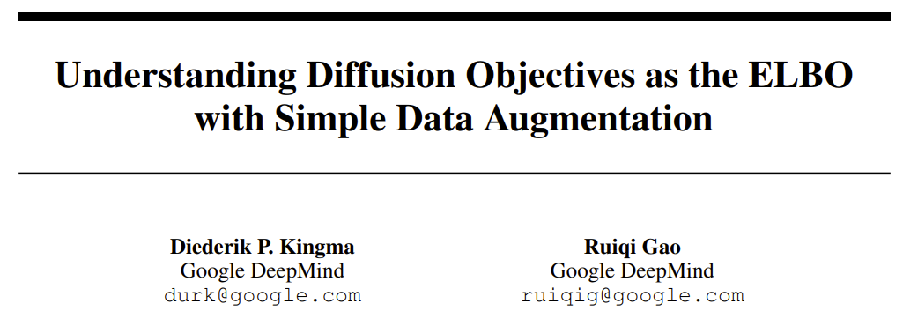
1. Weighting (unifying framework)
Very personal comments
ODE/SDE perspective
Help understanding details
(mainly) inspire sampling/ generation stage design
Loss/ prob. perspective
Help overall understanding
(mainly) inspire training stage design

Slide 4
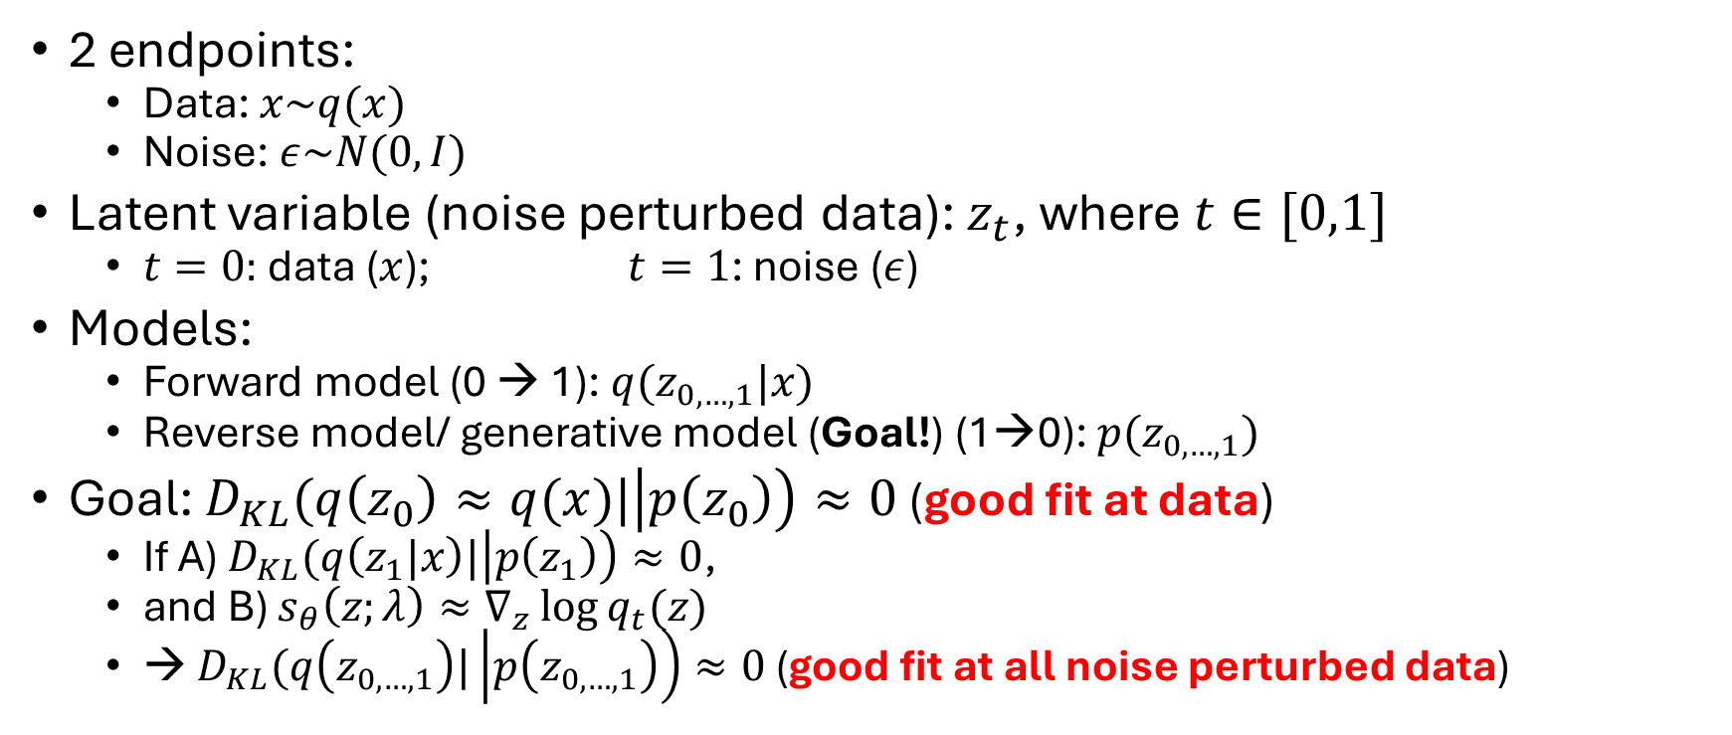
1. Weighting (unifying framework)
2 endpoints:
Data: $x\sim q(x)$
Noise: $ε\sim N(0,I)$
Latent variable (noise perturbed data): $z_{t}$, where $t∈[0,1]$
$t=0:$ data ($x$); $t=1$: noise ($ε$)
Models:
Forward model (0 → 1): $q(z_{0,…,1}|x)$
Reverse model/ generative model (Goal!) (1→0): $p(z_{0,…,1})$
Goal: $D_{KL}(q\left(z_{0}\right)≈q(x)|\left|p\left(z_{0}\right)\right)≈0$ (good fit at data)
If A) $D_{KL}(q\left(z_{1}|x\right)|\left|p\left(z_{1}\right)\right)≈0$,
and B) $s_{θ}\left(z;λ\right)≈∇_{z}\log{q_{t}(z)}$
→ $D_{KL}(q\left(z_{0,…,1}\right)|\left|p\left(z_{0,…,1}\right)\right)≈0$ (good fit at all noise perturbed data)

Slide 5
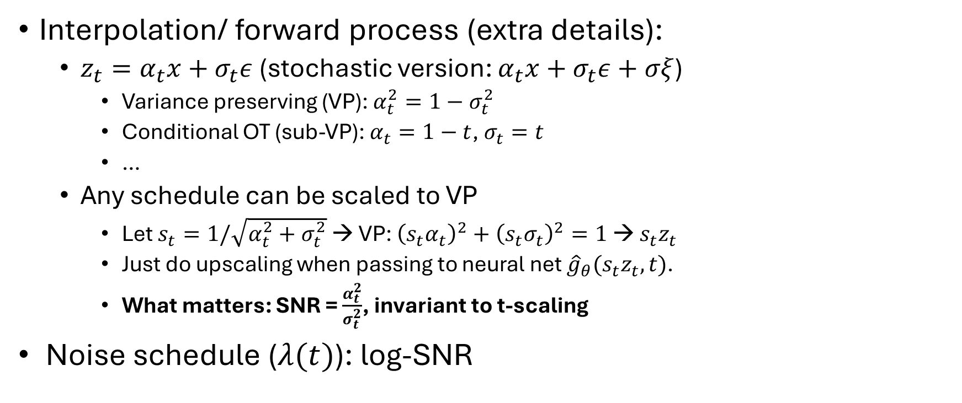
1. Weighting (unifying framework)
Interpolation/ forward process (extra details):
$z_{t}=α_{t}x+σ_{t}ε$ (stochastic version: $α_{t}x+σ_{t}ε+σξ$)
Variance preserving (VP): $α_{t}^{2}=1−σ_{t}^{2}$
Conditional OT (sub-VP): $α_{t}=1−t$, $σ_{t}=t$
…
Any schedule can be scaled to VP
Let $s_{t}=1/\sqrt{α_{t}^{2}+σ_{t}^{2}}$ → VP: ${\left(s_{t}α_{t}\right)}^{2}+{\left(s_{t}σ_{t}\right)}^{2}=1$ → $s_{t}z_{t}$
Just do upscaling when passing to neural net ${\hat{g}}_{θ}(s_{t}z_{t}, t)$.
What matters: SNR = $\frac{α_{t}^{2}}{σ_{t}^{2}}$, invariant to t-scaling
Noise schedule ($λ(t)$): log-SNR

Slide 6
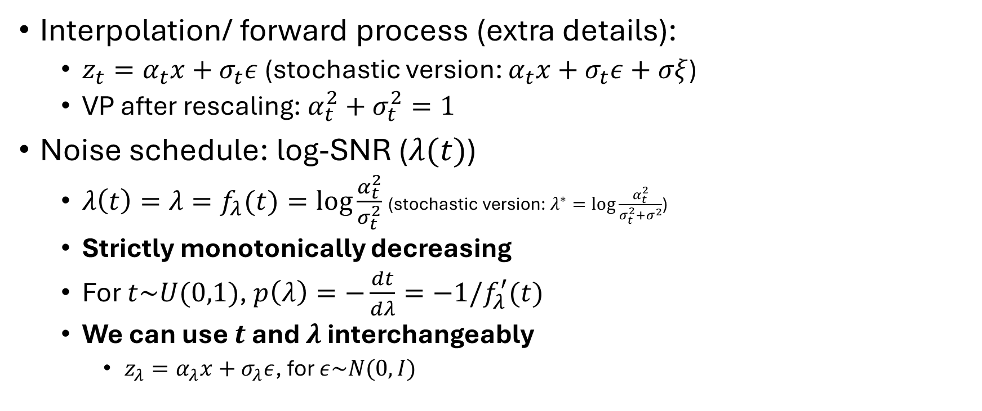
1. Weighting (unifying framework)
Interpolation/ forward process (extra details):
$z_{t}=α_{t}x+σ_{t}ε$ (stochastic version: $α_{t}x+σ_{t}ε+σξ$)
VP after rescaling: $α_{t}^{2}+σ_{t}^{2}=1$
Noise schedule: log-SNR ($λ(t)$)
$λ\left(t\right)=λ=f_{λ}(t)=\log{\frac{α_{t}^{2}}{σ_{t}^{2}}}$ (stochastic version: $λ^{∗}=\log{\frac{α_{t}^{2}}{σ_{t}^{2}+σ^{2}}}$)
Strictly monotonically decreasing
For $t\sim U(0,1)$, $p\left(λ\right)=−\frac{dt}{dλ}=−1/f_{λ}^{′}(t)$
We can use $t$ and $λ$ interchangeably
$z_{λ}=α_{λ}x+σ_{λ}ε$, for $ε\sim N(0,I)$

Slide 7
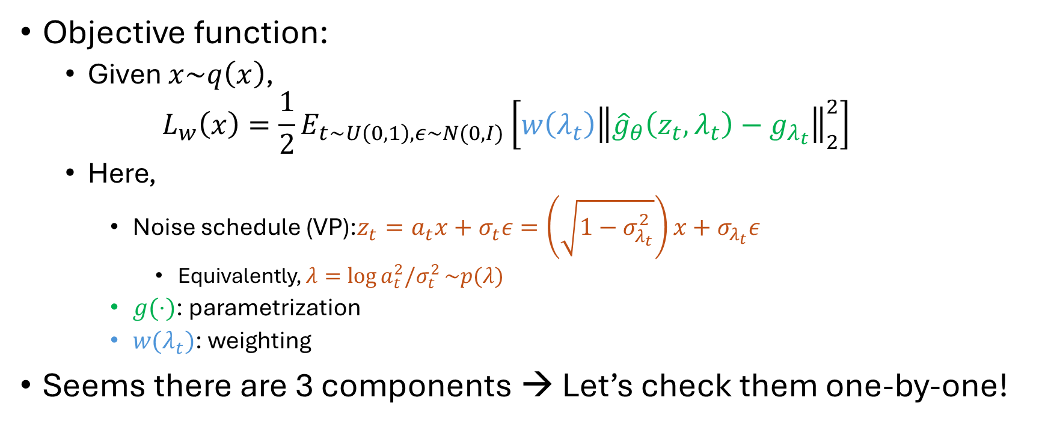
1. Weighting (unifying framework)
Objective function:
Given $x\sim q\left(x\right)$,
$$L_{w}\left(x\right)=\frac{1}{2}E_{t\sim U\left(0,1\right), ε\sim N(0,I)}\left[w\left(λ_{t}\right){\left\|{\hat{g}}_{θ}\left(z_{t},λ_{t}\right)−g_{λ_{t}}\right\|}_{2}^{2}\right]$$
Here,
Noise schedule (VP):$z_{t}=a_{t}x+σ_{t}ε=\left(\sqrt{1−σ_{λ_{t}}^{2}}\right)x+σ_{λ_{t}}ε$
Equivalently, $λ=\log{a_{t}^{2}/σ_{t}^{2}}\sim p(λ)$
$g(⋅)$: parametrization
$w(λ_{t})$: weighting
Seems there are 3 components → Let’s check them one-by-one!

Slide 8
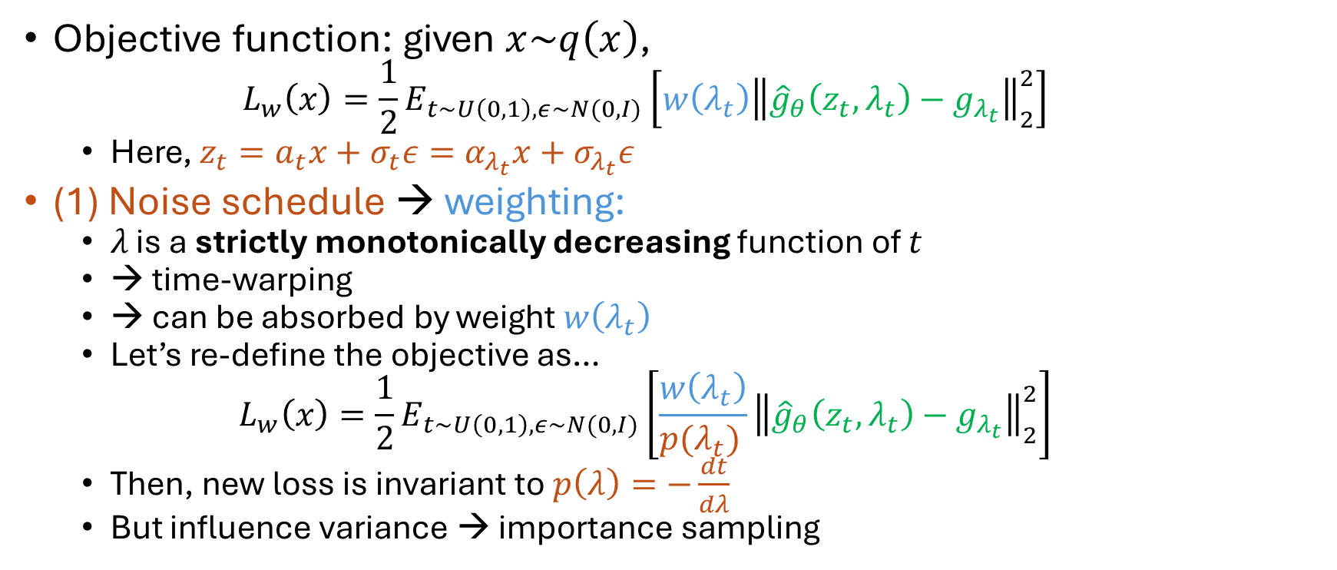
1. Weighting (unifying framework)
Objective function: given $x\sim q\left(x\right)$,
$$L_{w}\left(x\right)=\frac{1}{2}E_{t\sim U\left(0,1\right), ε\sim N(0,I)}\left[w\left(λ_{t}\right){\left\|{\hat{g}}_{θ}\left(z_{t},λ_{t}\right)−g_{λ_{t}}\right\|}_{2}^{2}\right]$$
Here, $z_{t}=a_{t}x+σ_{t}ε=α_{λ_{t}}x+σ_{λ_{t}}ε$
(1) Noise schedule → weighting:
$λ$ is a strictly monotonically decreasing function of $t$
→ time-warping
→ can be absorbed by weight $w\left(λ_{t}\right)$
Let’s re-define the objective as…
$$L_{w}\left(x\right)=\frac{1}{2}E_{t\sim U\left(0,1\right), ε\sim N(0,I)}\left[\frac{w\left(λ_{t}\right)}{p(λ_{t}) }{\left\|{\hat{g}}_{θ}\left(z_{t},λ_{t}\right)−g_{λ_{t}}\right\|}_{2}^{2}\right]$$
Then, new loss is invariant to $p\left(λ\right)=−\frac{dt}{dλ}$
But influence variance → importance sampling

Slide 9
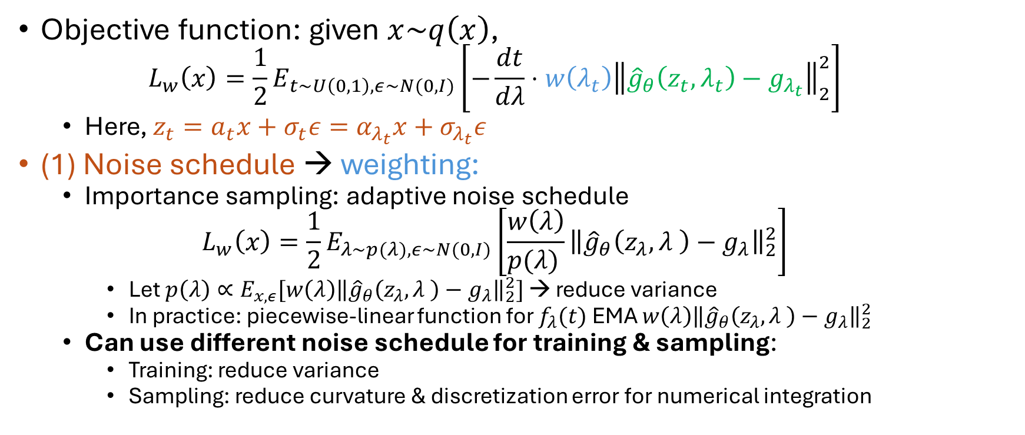
1. Weighting (unifying framework)
Objective function: given $x\sim q\left(x\right)$,
$$L_{w}\left(x\right)=\frac{1}{2}E_{t\sim U\left(0,1\right), ε\sim N(0,I)}\left[−\frac{dt}{dλ}⋅w\left(λ_{t}\right){\left\|{\hat{g}}_{θ}\left(z_{t},λ_{t}\right)−g_{λ_{t}}\right\|}_{2}^{2}\right]$$
Here, $z_{t}=a_{t}x+σ_{t}ε=α_{λ_{t}}x+σ_{λ_{t}}ε$
(1) Noise schedule → weighting:
Importance sampling: adaptive noise schedule
$$L_{w}\left(x\right)=\frac{1}{2}E_{λ\sim p(λ), ε\sim N(0,I)}\left[\frac{w\left(λ\right)}{p(λ) }{\left\|{\hat{g}}_{θ}\left(z_{λ},λ \right)−g_{λ}\right\|}_{2}^{2}\right]$$
Let $p\left(λ\right)∝E_{x,ε}[w\left(λ\right){\left\|{\hat{g}}_{θ}\left(z_{λ},λ \right)−g_{λ}\right\|}_{2}^{2}]$ → reduce variance
In practice: piecewise-linear function for $f_{λ}(t)$ EMA $w\left(λ\right){\left\|{\hat{g}}_{θ}\left(z_{λ},λ \right)−g_{λ}\right\|}_{2}^{2}$
Can use different noise schedule for training & sampling:
Training: reduce variance
Sampling: reduce curvature & discretization error for numerical integration

Slide 10
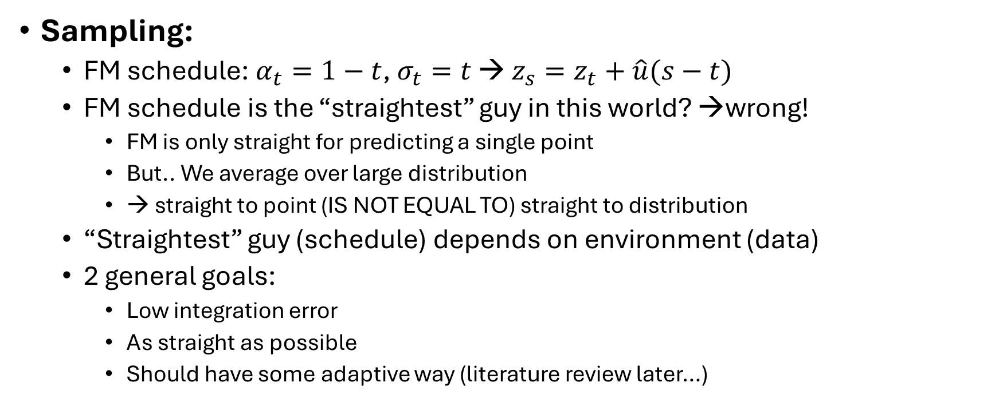
1. Weighting (unifying framework)
Sampling:
FM schedule: $α_{t}=1−t$, $σ_{t}=t$ → $z_{s}=z_{t}+\hat{u}(s−t)$
FM schedule is the “straightest” guy in this world? →wrong!
FM is only straight for predicting a single point
But.. We average over large distribution
→ straight to point (IS NOT EQUAL TO) straight to distribution
“Straightest” guy (schedule) depends on environment (data)
2 general goals:
Low integration error
As straight as possible
Should have some adaptive way (literature review later…)

Slide 11
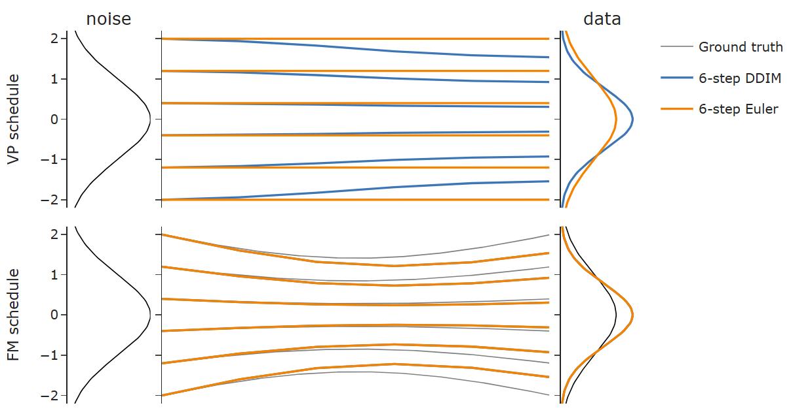
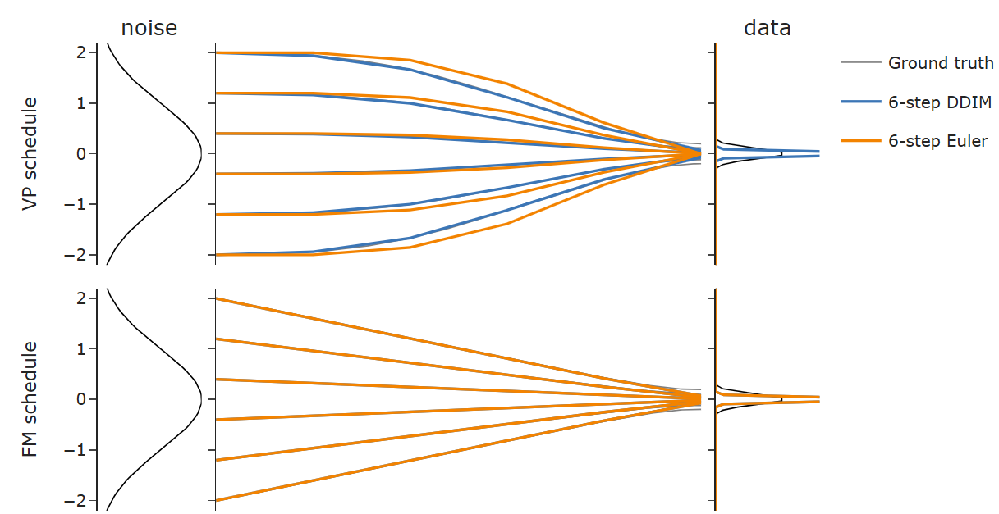
1. Weighting (unifying framework)

Slide 12
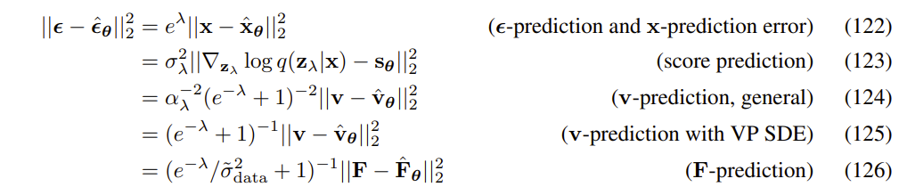
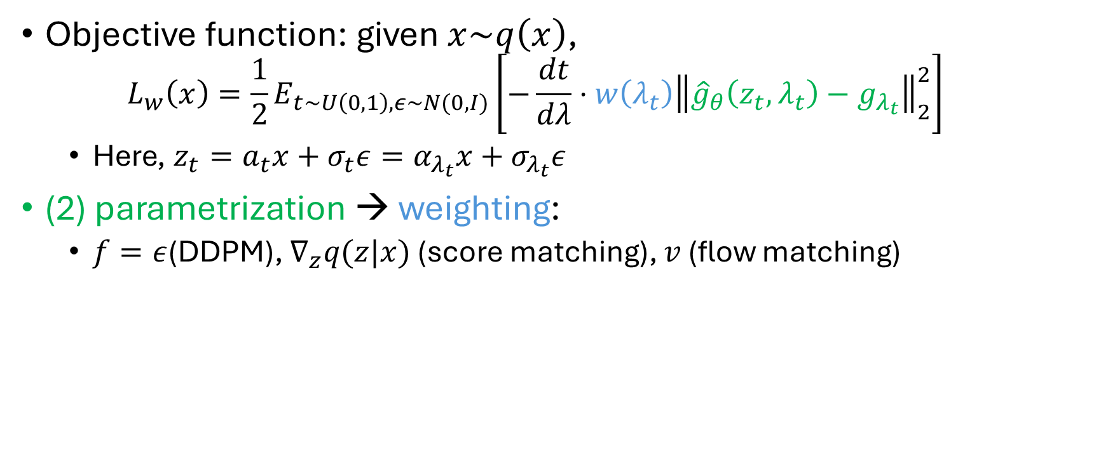
1. Weighting (unifying framework)
Objective function: given $x\sim q\left(x\right)$,
$$L_{w}\left(x\right)=\frac{1}{2}E_{t\sim U\left(0,1\right), ε\sim N(0,I)}\left[−\frac{dt}{dλ}⋅w\left(λ_{t}\right){\left\|{\hat{g}}_{θ}\left(z_{t},λ_{t}\right)−g_{λ_{t}}\right\|}_{2}^{2}\right]$$
Here, $z_{t}=a_{t}x+σ_{t}ε=α_{λ_{t}}x+σ_{λ_{t}}ε$
(2) parametrization → weighting:
$f=ε$(DDPM), $∇_{z}q(z|x)$ (score matching), $v$ (flow matching)

Slide 13
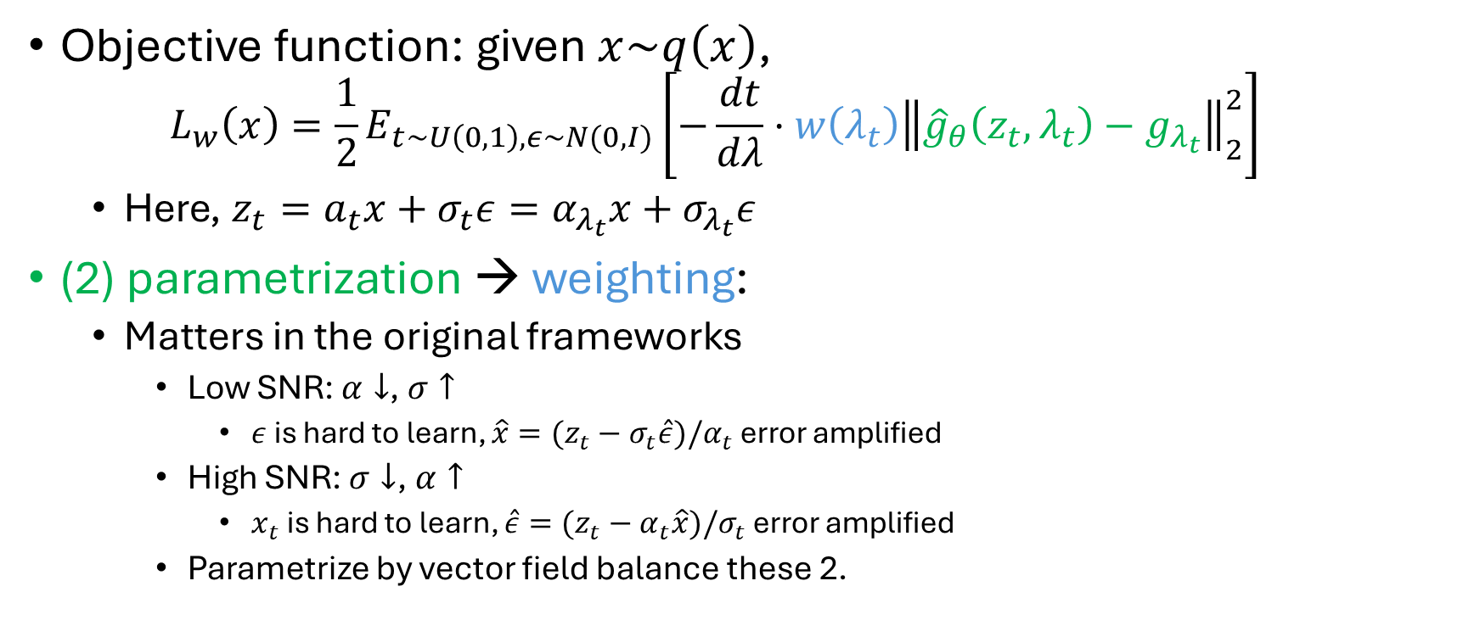
1. Weighting (unifying framework)
Objective function: given $x\sim q\left(x\right)$,
$$L_{w}\left(x\right)=\frac{1}{2}E_{t\sim U\left(0,1\right), ε\sim N(0,I)}\left[−\frac{dt}{dλ}⋅w\left(λ_{t}\right){\left\|{\hat{g}}_{θ}\left(z_{t},λ_{t}\right)−g_{λ_{t}}\right\|}_{2}^{2}\right]$$
Here, $z_{t}=a_{t}x+σ_{t}ε=α_{λ_{t}}x+σ_{λ_{t}}ε$
(2) parametrization → weighting:
Matters in the original frameworks
Low SNR: $α↓$, $σ↑$
$ε$ is hard to learn, $\hat{x}=(z_{t}−σ_{t}\hat{ε})/α_{t}$ error amplified
High SNR: $σ↓$, $α↑$
$x_{t}$ is hard to learn, $\hat{ε}=(z_{t}−α_{t}\hat{x})/σ_{t}$ error amplified
Parametrize by vector field balance these 2.

Slide 14
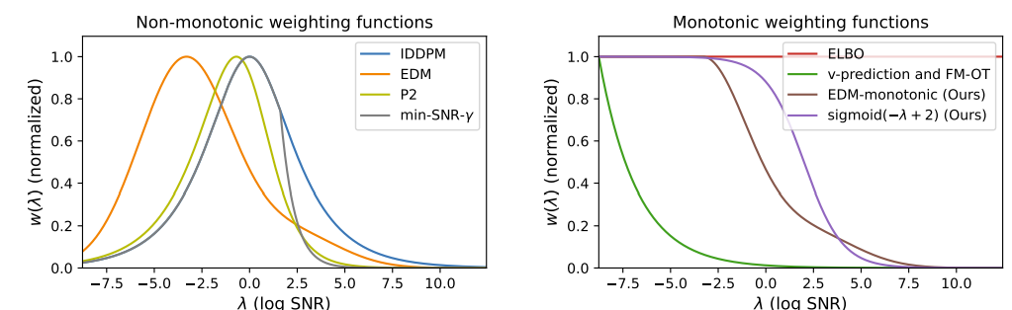

1. Weighting (unifying framework)
Objective function: given $x\sim q\left(x\right)$,
$$L_{w}\left(x\right)=\frac{1}{2}E_{t\sim U\left(0,1\right), ε\sim N(0,I)}\left[−\frac{dt}{dλ}⋅w\left(λ_{t}\right){\left\|{\hat{ε}}_{θ}\left(z_{t},λ_{t}\right)−ε\right\|}_{2}^{2}\right]$$
Here, $z_{t}=a_{t}x+σ_{t}ε=α_{λ_{t}}x+σ_{λ_{t}}ε$
(3) weighting
Heavy weight on low SNR
→ DM is good at perceptual data (image/ sound)
FM is super aggressive

Slide 15
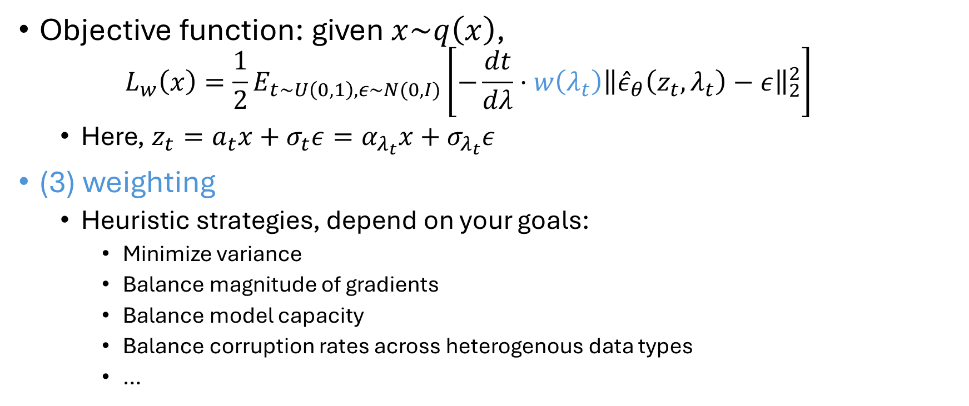
1. Weighting (unifying framework)
Objective function: given $x\sim q\left(x\right)$,
$$L_{w}\left(x\right)=\frac{1}{2}E_{t\sim U\left(0,1\right), ε\sim N(0,I)}\left[−\frac{dt}{dλ}⋅w\left(λ_{t}\right){\left\|{\hat{ε}}_{θ}\left(z_{t},λ_{t}\right)−ε\right\|}_{2}^{2}\right]$$
Here, $z_{t}=a_{t}x+σ_{t}ε=α_{λ_{t}}x+σ_{λ_{t}}ε$
(3) weighting
Heuristic strategies, depend on your goals:
Minimize variance
Balance magnitude of gradients
Balance model capacity
Balance corruption rates across heterogenous data types
…

Slide 16
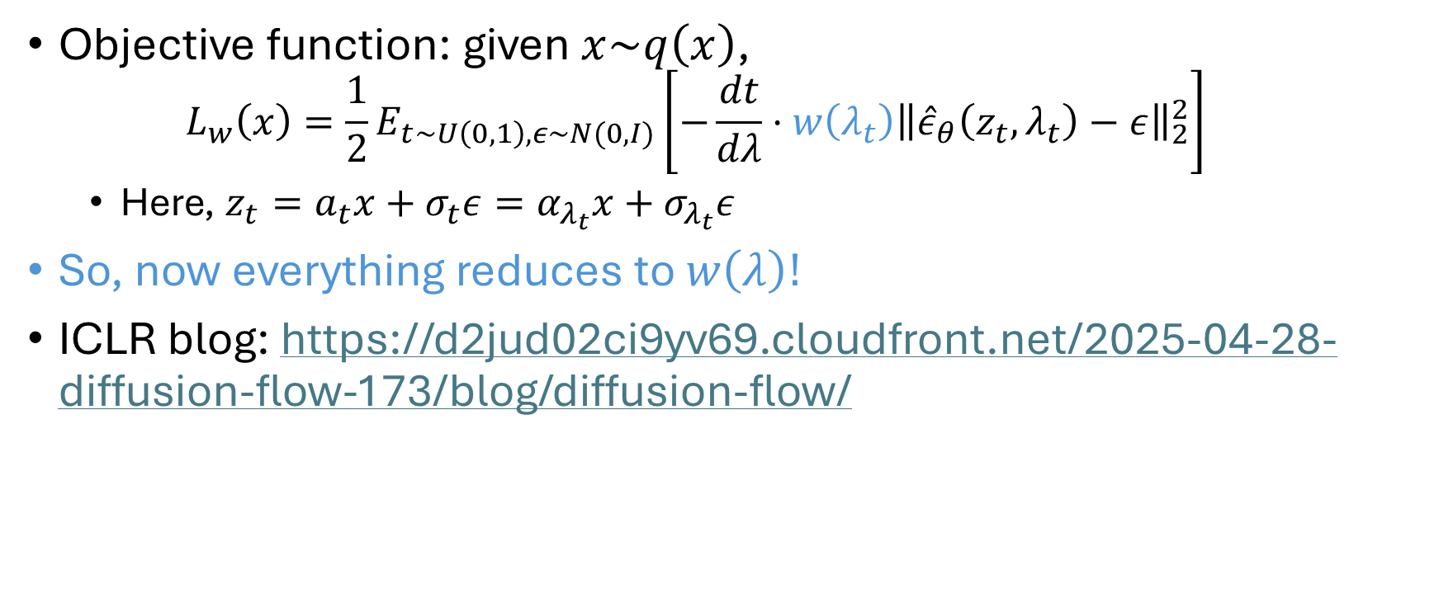
1. Weighting (unifying framework)
Objective function: given $x\sim q\left(x\right)$,
$$L_{w}\left(x\right)=\frac{1}{2}E_{t\sim U\left(0,1\right), ε\sim N(0,I)}\left[−\frac{dt}{dλ}⋅w\left(λ_{t}\right){\left\|{\hat{ε}}_{θ}\left(z_{t},λ_{t}\right)−ε\right\|}_{2}^{2}\right]$$
Here, $z_{t}=a_{t}x+σ_{t}ε=α_{λ_{t}}x+σ_{λ_{t}}ε$
So, now everything reduces to $w\left(λ\right)!$
ICLR blog: https://d2jud02ci9yv69.cloudfront.net/2025-04-28-diffusion-flow-173/blog/diffusion-flow/

Slide 17
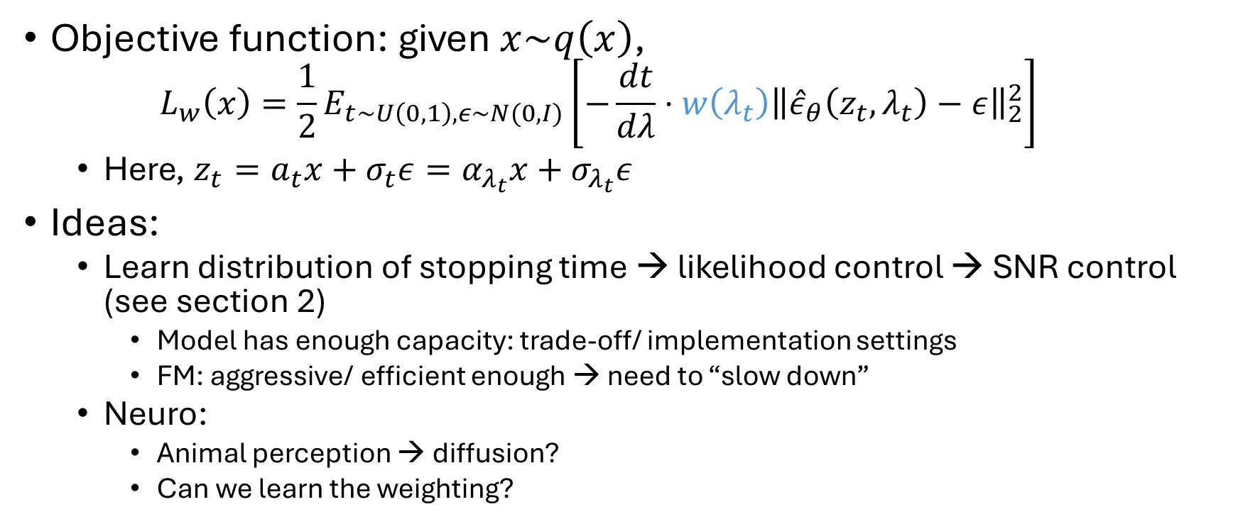
1. Weighting (unifying framework)
Objective function: given $x\sim q\left(x\right)$,
$$L_{w}\left(x\right)=\frac{1}{2}E_{t\sim U\left(0,1\right), ε\sim N(0,I)}\left[−\frac{dt}{dλ}⋅w\left(λ_{t}\right){\left\|{\hat{ε}}_{θ}\left(z_{t},λ_{t}\right)−ε\right\|}_{2}^{2}\right]$$
Here, $z_{t}=a_{t}x+σ_{t}ε=α_{λ_{t}}x+σ_{λ_{t}}ε$
Ideas:
Learn distribution of stopping time → likelihood control → SNR control (see section 2)
Model has enough capacity: trade-off/ implementation settings
FM: aggressive/ efficient enough → need to “slow down”
Neuro:
Animal perception → diffusion?
Can we learn the weighting?

Slide 18




2. Likelihood/ ELBO & Diffusion loss
Still from the “Understanding” paper
This is what Durk really good at, lol
Define:
Step 1: link KL to SNR:
Proof is very easy to follow, but the key step is in Kingma et al., 2021 😂

Slide 19


2. Likelihood/ ELBO & Diffusion loss
If…
$w(λ_{t})$ is monotonically increasing to $t$ (decreasing for $λ$)
w.l.o.g., assume $w\left(λ_{1}\right)=1$
, where $p_{w}\left(t\right)=\frac{dw\left(λ_{t}\right)}{dt}+δ_{0}w(λ_{max})$
Step 2: link KL to ELBO

Slide 20
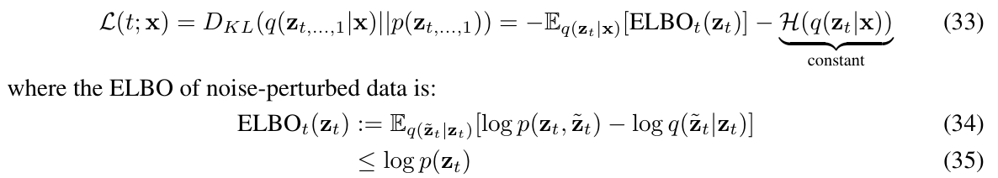
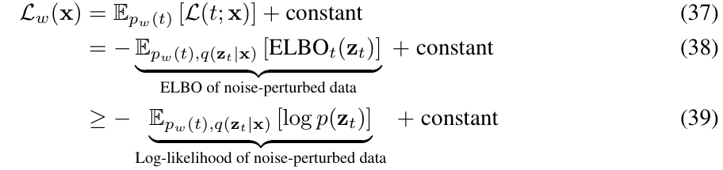
2. Likelihood/ ELBO & Diffusion loss

Slide 21
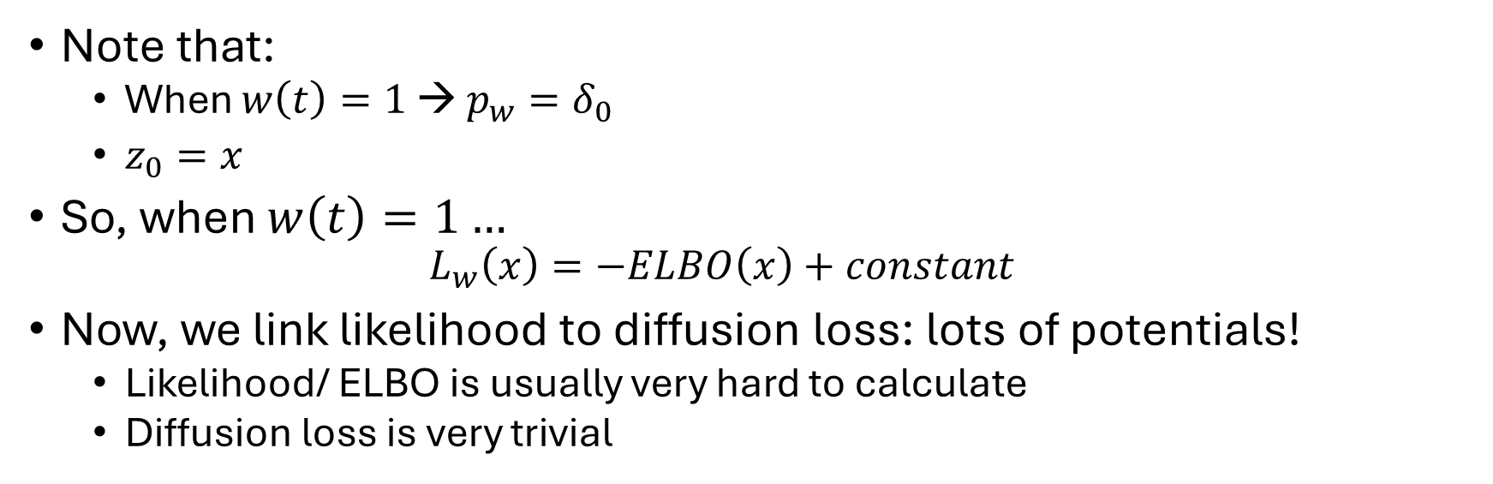
2. Likelihood/ ELBO & Diffusion loss
Note that:
When $w\left(t\right)=1$ → $p_{w}=δ_{0}$
$z_{0}=x$
So, when $w\left(t\right)=1…$
$$L_{w}\left(x\right)=−ELBO\left(x\right)+constant$$
Now, we link likelihood to diffusion loss: lots of potentials!
Likelihood/ ELBO is usually very hard to calculate
Diffusion loss is very trivial

Slide 22
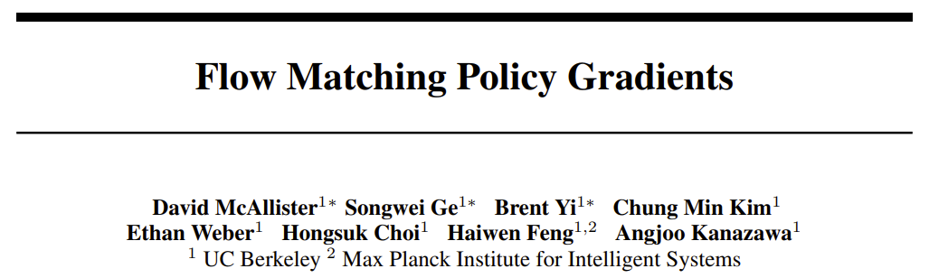
2. Likelihood/ ELBO & Diffusion loss (e.g.1)
Example 1: Policy gradient → FM policy gradient

Slide 23


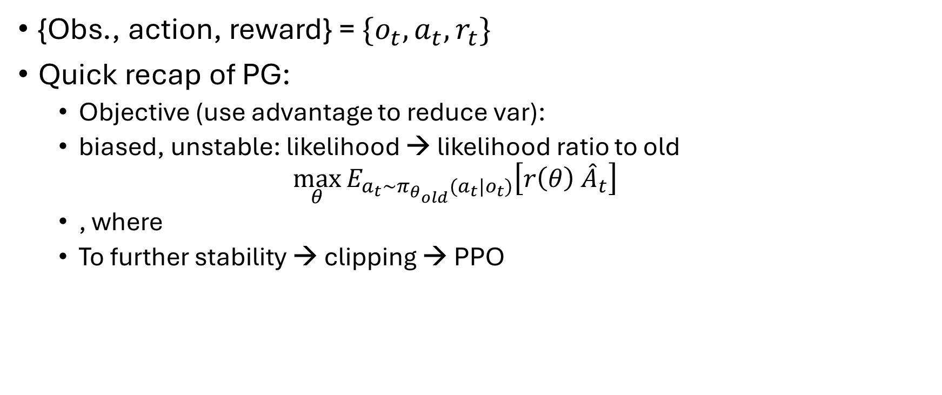
2. Likelihood/ ELBO & Diffusion loss (e.g.1)
{Obs., action, reward} = $\{o_{t},a_{t},r_{t}\}$
Quick recap of PG:
Objective (use advantage to reduce var):
biased, unstable: likelihood → likelihood ratio to old
$$\max_{θ}{E_{a_{t}\sim π_{θ_{old}}(a_{t}|o_{t})}\left[r\left(θ\right) {\hat{A}}_{t}\right]}$$
, where
To further stability → clipping → PPO

Slide 24

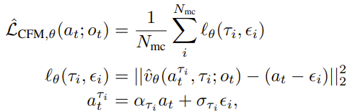

2. Likelihood/ ELBO & Diffusion loss (e.g.1)
Key problem: likelihood ratio
Likelihood: hard to evaluate…
Replace $log⁡(π(a_{t}|o_{t}))$ by
When $w\left(t\right)=1$: just ELBO($a_{t}$)
Then, remaining is very trivial…

Slide 25
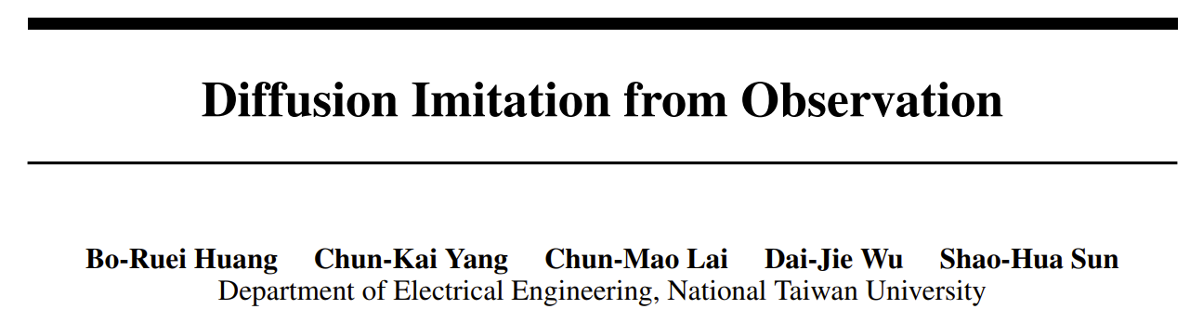
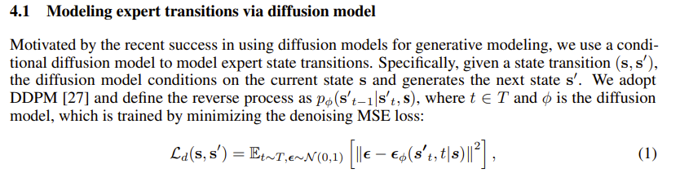
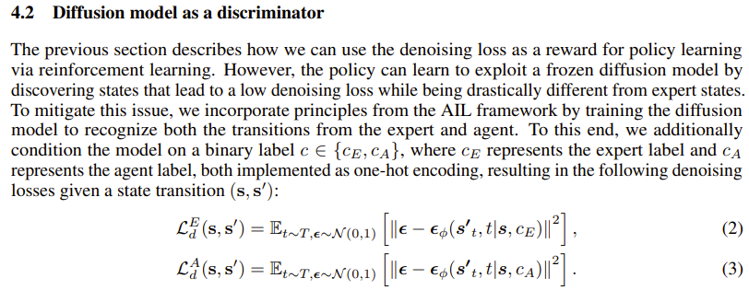
2. Likelihood/ ELBO & Diffusion loss (e.g.2s)
Example 2: imitation learning
(NeurIPS’24)

Slide 26
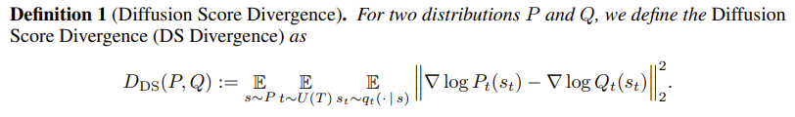
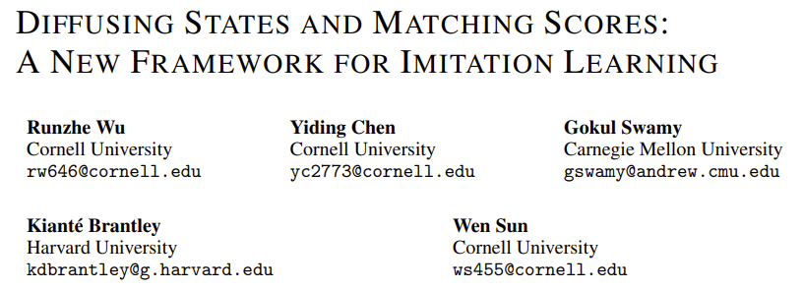
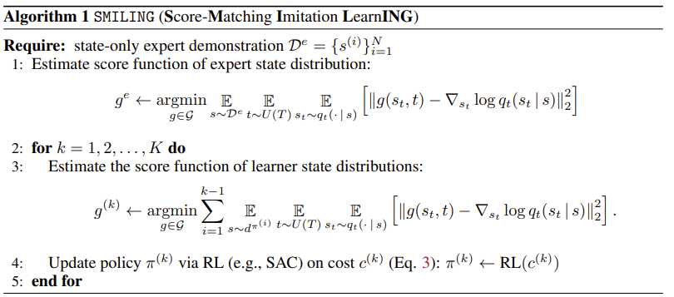
2. Likelihood/ ELBO & Diffusion loss (e.g.2)
(ICLR’25)

Slide 27



3. Prior help for DM
Which is easier?

Slide 28
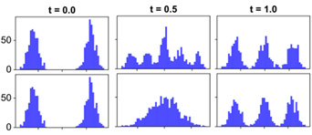
3. Prior help for DM
Linear
deterministic
stochastic
😝? 😔!

Slide 29
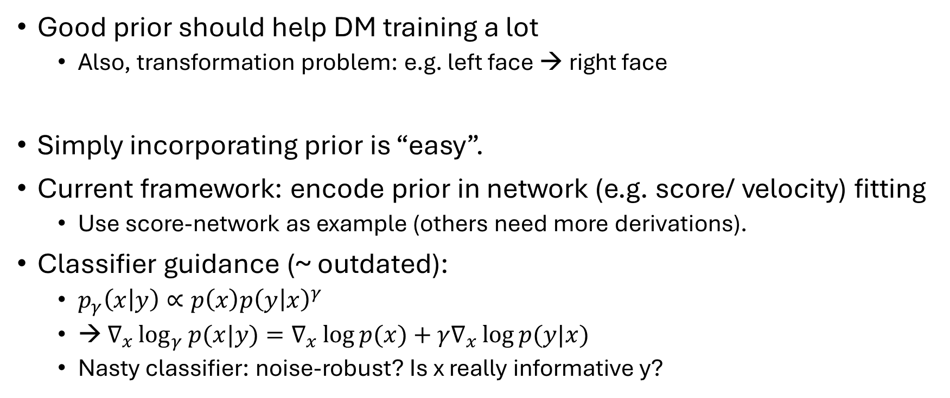
3. Prior help for DM
Good prior should help DM training a lot
Also, transformation problem: e.g. left face → right face
Simply incorporating prior is “easy”.
Current framework: encode prior in network (e.g. score/ velocity) fitting
Use score-network as example (others need more derivations).
Classifier guidance (~ outdated):
$p_{γ}\left(x | y\right)∝p\left(x\right)p{\left(y | x\right)}^{γ}$
→ $∇_{x}\log_{γ}{p(x|y)}=∇_{x}\log{p(x)}+γ∇_{x}\log{p(y|x)}$
Nasty classifier: noise-robust? Is x really informative y?

Slide 30
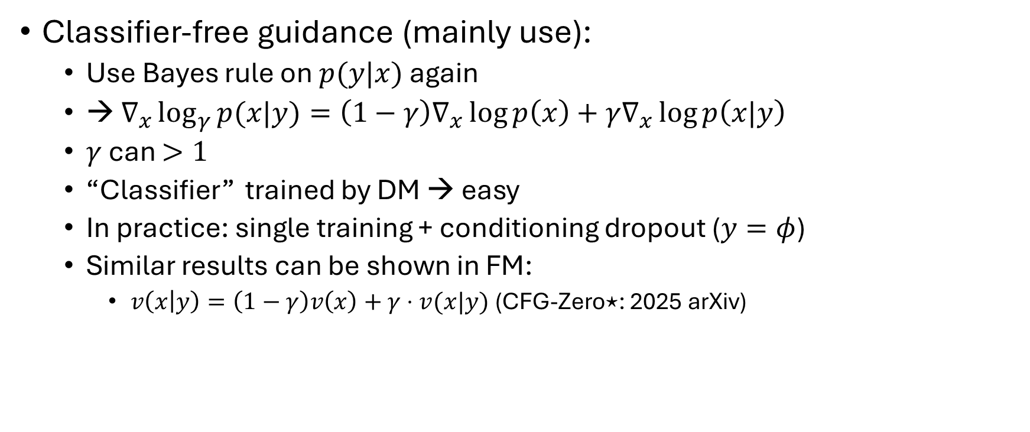
3. Prior help for DM
Classifier-free guidance (mainly use):
Use Bayes rule on $p(y|x)$ again
→ $∇_{x}\log_{γ}{p(x|y)}=\left(1−γ\right)∇_{x}\log{p\left(x\right)}+γ∇_{x}\log{p\left(x|y\right)}$
$γ$ can $>1$
“Classifier” trained by DM → easy
In practice: single training + conditioning dropout ($y=φ$)
Similar results can be shown in FM:
$v\left(x | y\right)=\left(1−γ\right)v\left(x\right)+γ⋅v(x|y)$ (CFG-Zero⋆: 2025 arXiv)

Slide 31
4. Sampling/ generation
Speed up in 2 ways:
Skip some steps, e.g., DDIM/ Taylor expansion
Parallel (should be trivial implementation of Scott’s method)
Noise schedule design: previous
Diversity issue: community main focus

